Slide 1


Emotions

Slide 2
Key Points
01
To enable students to learn what is emotion
02
To know the components of emotions
03
To know the functions of emotions

Slide 3
Emotions
“Feelings that generally have both physiological and cognitive elements and that influence behavior”

Slide 4

Emotions are whole-body experiences, combining feelings, thoughts and bodily sensations.
Emotions are reaction to an object, i.e., they are object specific.

Slide 5
At one time or another, all of us have experienced the strong feelings that
accompany both very pleasant and very negative experiences. Perhaps we have
felt the thrill of getting a desired job, the joy of being in love, or the sorrow
over someone’s death.
Moreover, we experience such reactions on a less intense level throughout our daily lives with such things as the pleasure of a friendship, the enjoyment of a movie, and the embarrassment of breaking a borrowed item.

Slide 6
Components of Emotion
Feelings
Social-
Expressive
Emotion
Bodily
Arousal
Sense of
Purpose
Significant life event

Slide 7
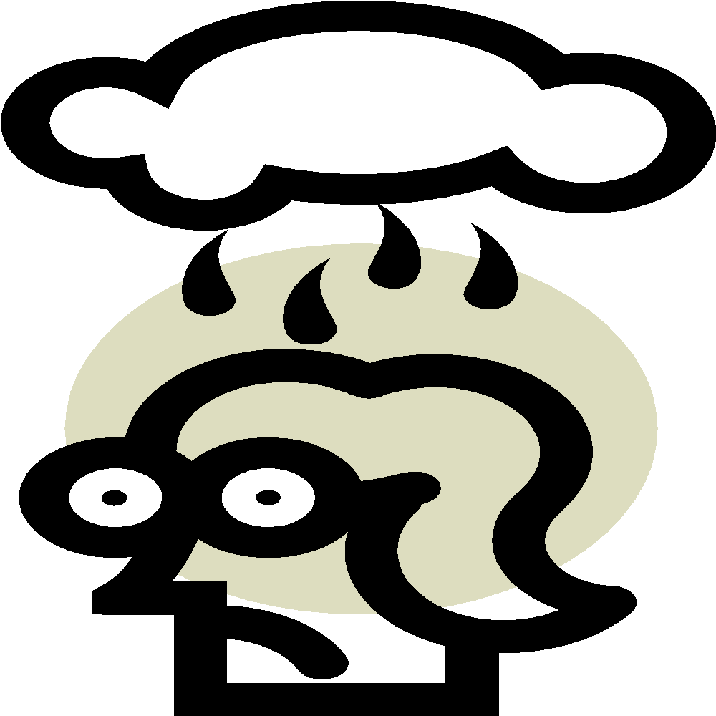

Feeling component:
Emotions are individual feelings
Make us feel in a particular way.
Anger or joy.
Bodily Arousal:
Biological activation.
Prepare and activate adaptive coping behavior during emotion.
Body prepared for action.
Alert posture

Slide 8


Sense of Purpose:
Give emotion its goal-directed force.
Motivation to take action.
Social-Expressive component:
Postures, gestures, vocalizations, facial expressions make our emotions public.
Verbal and nonverbal communication.
Helps us interpret the situation.
How person reacts to event.

Slide 9
Think about how it feels to be happy,
First, we experience a feeling that we can differentiate from other emotions. It is
likely that we also experience some identifiable physical changes in our bodies,
Perhaps the heart rate increases
Finally, the emotion probably encompasses cognitive elements, Our understanding and evaluation of the meaning of what is happening prompts our feelings of
happiness.

Slide 10
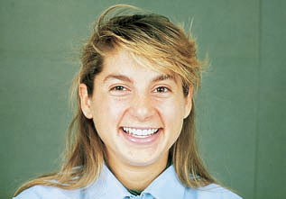
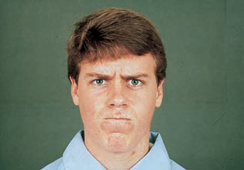
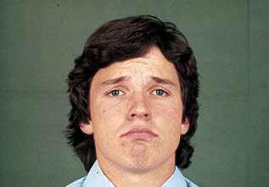
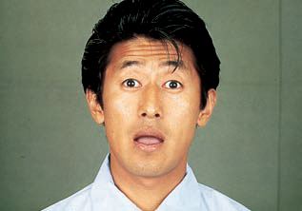
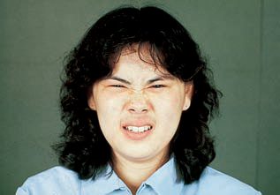
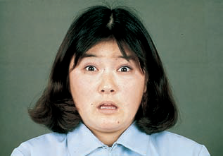
Six of the Primary Emotions:
Happiness, Anger, Sadness, Surprise, Disgust, Fear

Slide 11
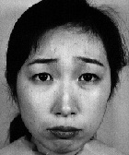
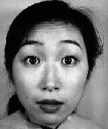
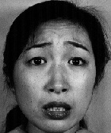
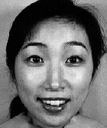
Which of the following faces is expressing happiness, surprise, anger, sadness?
A
B
C
D

Slide 12
The Functions of Emotions
Preparing us for action: Any threatening stimulus gives us signals of danger and prepare our body to respond accordingly, “Fight-or-Flight”.
Shaping our future behavior: Past unpleasant events teach a person to avoid similar circumstances in the future.
Helping us interact more effectively with others: Our verbal and non-verbal expression to emotions clearly communicated what we are experience, to observer.

Slide 13
What Emotions Can Do for Us?
Our emotions ,when functioning well can,
Help us find out what we want and what is right for us.
Tell us something needs changing in us ,in others and in the world.
Help communicate our priorities and needs to others.
Help us empathize with others. Warn us of danger.
Motivate us to grow.
Helps us clarify our own values and guides us.

Slide 14
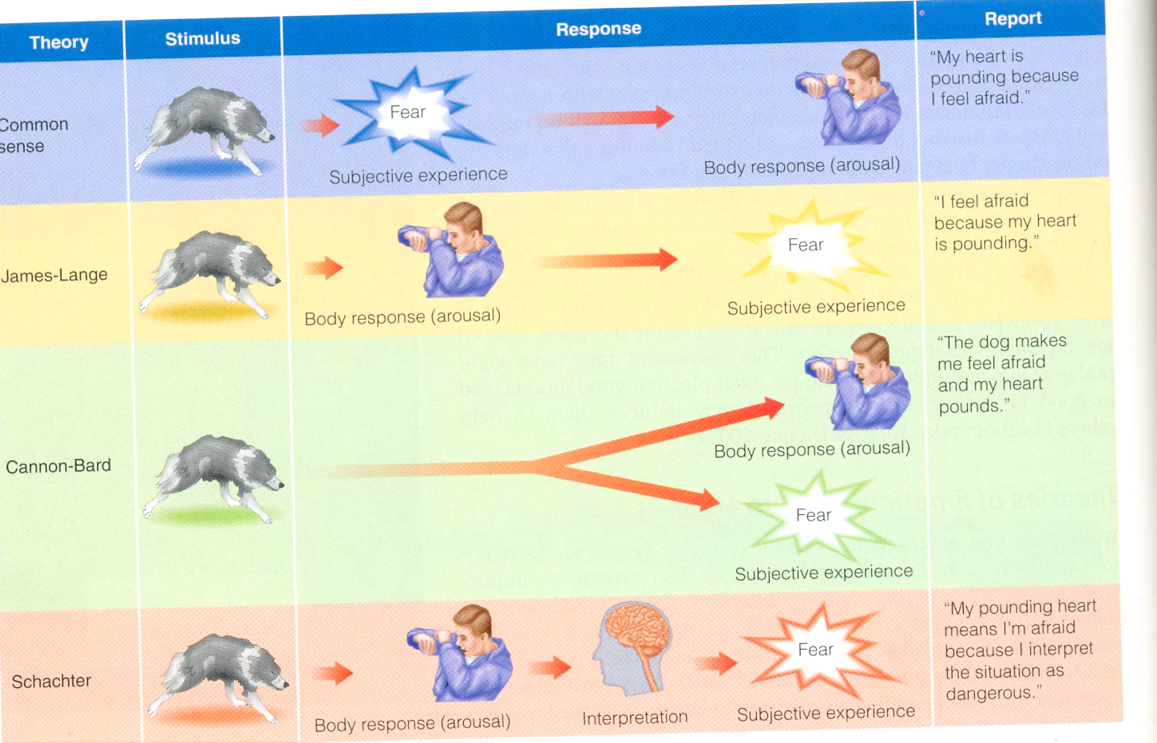
The Roots of Emotions

Slide 15
Knowing emotions is the first step … But Managing them is more important

Slide 16
Task # 2 (Pre-Session) Visit the following link and attempt an on-line quiz to check your understanding about different emotions. https://greatergood.berkeley.edu/quizzes/ei_quiz/take_quiz or https://www.ihhp.com/free-eq-quiz/

Slide 17
Thank you

